Slide 1
Start a conversation
“
An important conversation about unnecessary tests, treatments and procedures.
”

Slide 2
A global social movement
Start a conversation
Effect a culture shift
20 countries and growing
Notes:
Launched in US in 2012, Australia in 2015
One third of all OECD countries involved

Slide 3
Principles
Notes:
These are the core principles of CW and seen as the key factors critical to its success. Members and supporters must agree to these principles in relation to using the CW name and brand.

Slide 4
Recommendations
Transparent
Quality of care focus
Evidence based
Starts a conversation
Lists of “5 things to question”
Notes:
A key resource of the initiative is the recommendations produced by the colleges, societies and associations. This strong involvement gives the initiative credibility.

Slide 5
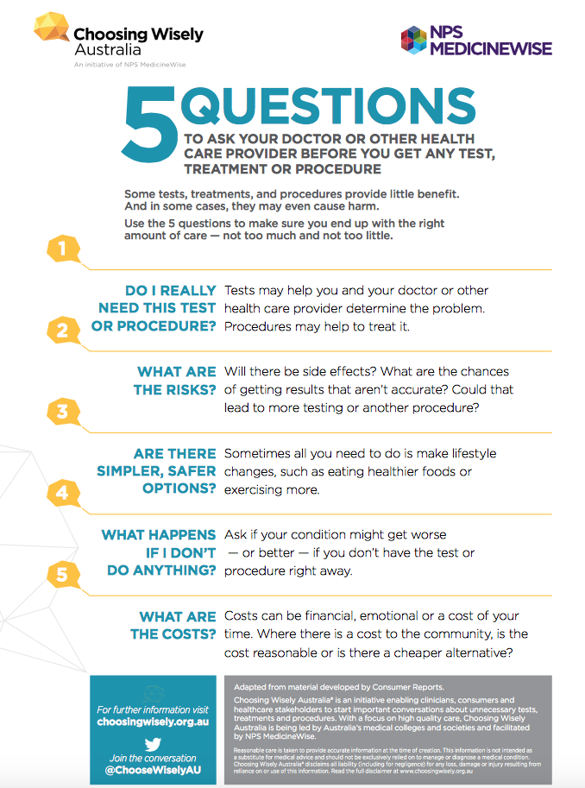
5 questions to ask
Do I really need this test?
What are the risks?
Are there safer options?
What if I do nothing?
What are the costs?
Notes:
Second key resource – supports a conversation between health professionals and consumers about what care is truly necessary.

Slide 6
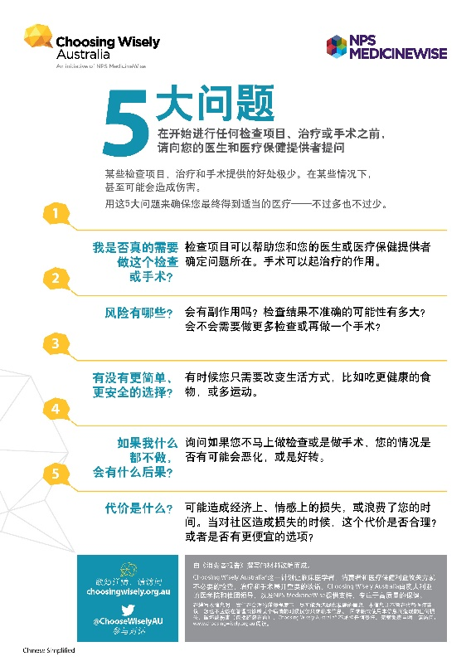
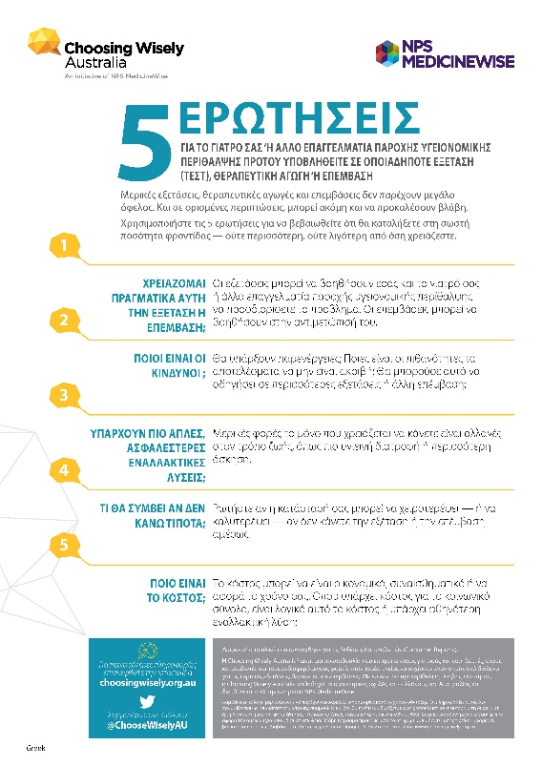
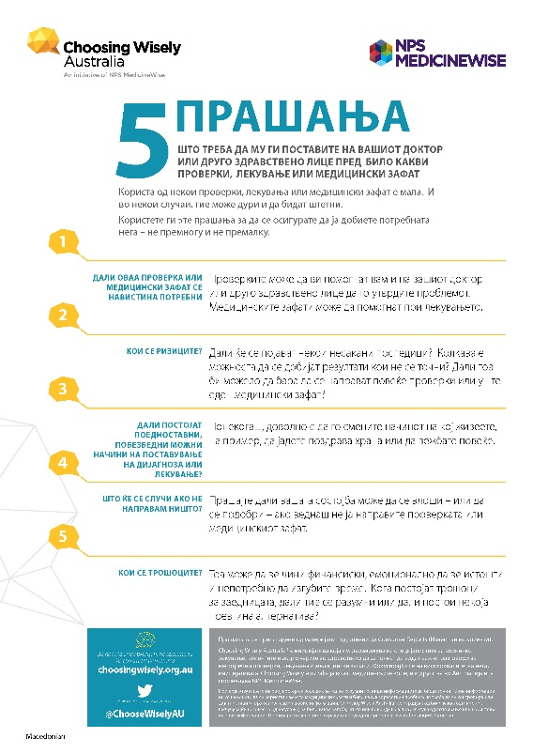
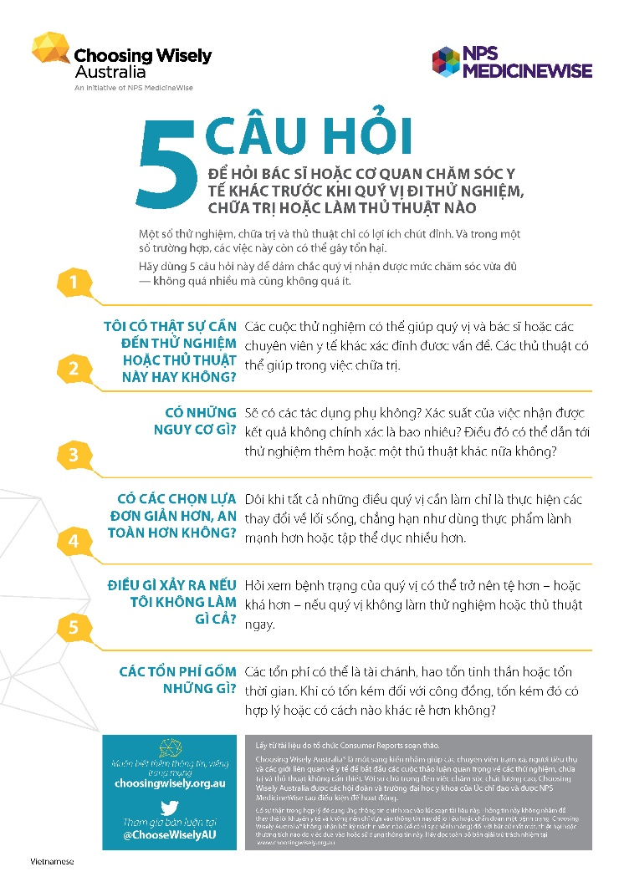
Empowerment in 12 languages
Notes:
Second key resource – supports a conversation between health professionals and consumers about what care is truly necessary.

Slide 7
93
MEMBERS
1,070
GENERAL NEWS
+
69
TRADE MEDIA REPORTS
45
GP AWARENESS
93%
SPECIALIST
HEALTH
PROFESSIONAL
COLLEGES,
SOCIETIES
& ASSOCIATIONS
GREW TO
59%
MEDICAL
COLLEGES
ARE MEMBERS
FACEBOOK
5%
96,000+
WEBSITE SESSIONS
FOLLOWER
INCREASE
39
TWITTER
14%
CHAMPION
HEALTH
SERVICES
FOLLOWER
INCREASE
SPECIALISTS’ AWARENESS
LINKEDIN
40%
9
GREW TO
49%
CONSUMER INFORMATION &
ADVOCACY ORGANISATIONS
FOLLOWER
INCREASE
Statistics from Choosing Wisely Australia 2019 Report – Partnering for Change
Notes:
Key message 1: Our membership is increasing and diversifying.
Notes:
From an initial 6 colleges, we now have 45 colleges, societies and associations including 93% of Australian Medical Colleges.
We continue to welcome new colleges, associations and societies (and the partnership with RACP and their aligned EVOLVE program has been very positive).
We also have a growing network of 39 Champion Health Services who are actively implementing Choosing Wisely initiatives. We are also proud of our 9 consumer organisations.
Growing membership is important for a number of reasons.
Increased membership supports increasing awareness and we are seeing an increase in awareness especially with health professionals year on year

Slide 8
Multi-profession
45
SPECIALIST
HEALTH
PROFESSIONAL
COLLEGES,
SOCIETIES
& ASSOCIATIONS
Notes:
45 colleges, societies and associations
39 health service partners
Consumer partnerships (incl. PHNs)
93% of medical colleges
Includes RACP/EVOLVE

Slide 9
Consumer
Notes:
9 consumer organisations

Slide 10
GP reasons for unnecessary tests
NPS MedicineWise Program evaluation 2018, The Choosing Wisely Australia Initiative: Year 3 Evaluation Report, NPS MedicineWise, Sydney.

Slide 11
Specialist reasons for unnecessary tests
NPS MedicineWise Program evaluation 2018, The Choosing Wisely Australia Initiative: Year 3 Evaluation Report, NPS MedicineWise, Sydney.

Slide 12
Reasons for unnecessary tests
GPs and specialists
cite patient expectations as a major driver
CONSUMERS
Only 16% of surveyed Australians said they ask for tests
“patient expectations”
vs

Slide 13
NPS MedicineWise’s role
Governance
Membership recruitment
Forums for networking, sharing and learning
Communications and media
Implementation
Evaluation
Convenes advisory group

Slide 14
Programs with impact
Multifaceted activities:
CPD activities
Face to face educational visit
Online case study
MBS Feedback to >25,000 GPs
Resources
MedicineWise News, videos
Patient action plan
Significant improvements:
Aware of Ottawa Rules (up by +51%)
Knowledge of appropriate care path (+24%)
Confidence to assess and communicate (+17%)
Actual practice: 74% had increased use (or intention) of Ottawa Rules

Slide 15
Champion health services
“Choosing Wisely has been a very powerful vehicle to bring all those disciplines in under one big umbrella”
Dr Simon Judkins, Austin Health
Toolkits Comms support Patient resources Evaluation tools Monthly webinars
Notes:
A list of current members can be found on the CW website.

Slide 16
Toolkits
Implementation Toolkit – Better Care Victoria
Conversation starter kit
Stewardship Toolkit for Clinical Educators
Choosing Wisely in General Practice

Slide 17
Consumer engagement
Positive messages
Creating supportive environments
Local health service pilots
Co-designing with consumers
Notes:
Consumer engagement through empowering them to ask questions
Our primary message to consumers is a positive message that encourages them to ask questions so that they might become better informed on the options, alternatives, risks and benefits and associated costs.
We are encouraging conversations between consumers and health professionals, and seeing to create environments that support conversations and provide the permission that consumers often feel they don't have. This approach has been informed by active consumer consultation from inception.
We have much work to do in this area but there are a number of things that are worth highlighting.
In particular, promoting the use of the 5 questions to ask your Dr.
The ongoing support and commitment of CHF and Health Direct in promoting the messaging of CW
54% of Colleges have reported working on developing consumer resources
Champion health services are actively seeking ways to engage with their consumer committees in their work. Many are including the 5 questions into patient packs and promoting throughout the hospitals
We are piloting resources to support creating permissible environments in a number of health services. Results will inform ongoing work in hospitals but is also a test bed for engagement in primary care
We have an active Consumer Expert Working Group - co-chaired with CHF, which includes HPs, consumers and PHNs. Developing strategies and tools to support consumer engagement at a number of levels.

Slide 18
Get involved
Become a member or supporter
Get the newsletter
choosingwisely.org.au
Get social
@ChooseWiselyAU
@ChoosingWiselyAustralia
Choosing Wisely Australia

