Slide 1
Peripheral blood testing for coeliac disease
Gastroenterological Society of Australia

Slide 2
Jaswinder
Patient medical history (PMHx)
25-year-old female, north Indian background
Only medication: oral contraceptive pill (for menorrhagia control) for 7 years
Allergic rhinitis on PRN antihistamines
Works as accountant
Vegetarian but otherwise no dietary restrictions
No relevant family history of gastrointestinal disorders
Symptoms
Three years of abdominal cramps, bloating, diarrhoea
Triggered by wheat and dairy
Increasing fatigue in the last year

Slide 3
Jaswinder
Examination
Blood pressure, heart rate, temperature, respiratory rate within normal limits
Weight 49 kg, height 1.67 cm, BMI 17.6 kg/m2
Mildly tender epigastric area on palpation
No abdominal organomegaly or ascites
Tests / Investigations
Full blood count= haemoglobin 105 g/L (normal =110 - 140 g/L), MCV 78 fL (normal 80 fL - 95 fL)
Renal and liver function tests normal
Thyroid function tests normal
Stool tests= no bacterial or parasite infections
Ferritin 10 μg/L (normal 20 μg/L - 160 μg/L)

Slide 4
What blood tests are suitable next steps to investigate for possible coeliac disease?
Serology: anti-tissue transglutaminase IgA
Serology: anti-deamidated gliadin IgG
HLA-DQ2 and HLA-DQ8 genotyping
Total IgA levels

Slide 5
What blood tests are suitable next steps to investigate for possible coeliac disease?
Serology: anti-tissue transglutaminase IgA
Serology: anti-deamidated gliadin IgG
HLA-DQ2 and HLA-DQ8 genotyping
Total IgA levels

Slide 6
Choosing Wisely Australia Recommendation Do not undertake genetic testing for coeliac genes as a screening test for coeliac disease
Gastroenterological Society of Australia

Slide 7
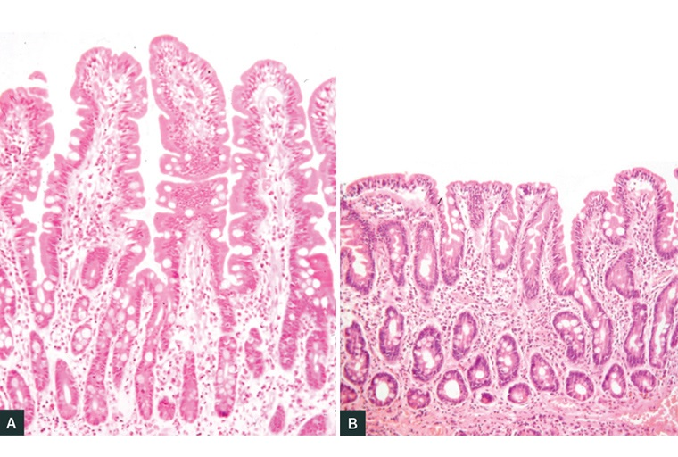
What is best practice?
Testing for coeliac disease should initially be serological testing (following an adequate gluten challenge: the equivalent of 3-6g daily (4 slices bread, 2-4 weetbix or 1 cup pasta) for 4 weeks
Ideally, a combination of IgA and IgG based serological tests should be used eg. anti-tissue transglutaminase (tTG) IgA/IgG and anti-deamidated gliadin peptide IgA/IgG
Total IgA levels should be tested to rule out concomitant IgA deficiency (seen in 3-5% of those with coeliac disease) especially if IgA based coeliac tests are used
If serology is positive, endoscopy and small bowel biopsy is the subsequent gold standard to confirm diagnosis
Normal small bowel mucosa.
Small bowel mucosa demonstrating villous atrophy, lymphocytes and crypt hyperplasia characteristic of coeliac disease.
From: Tye-Din J, ‘Interpreting tests for coeliac disease: Tips, pitfalls and updates’, AJGP 2018; 47(1-2)

Slide 8
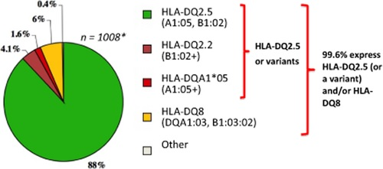
Why not do genetic testing as screening?
The susceptibility genes HLA-DQ2 and HLA-DQ8 are highly sensitive for coeliac disease (over 99% of coeliac patients will have one of these genotypes)
However they are very poorly specific: up to 50% of the Australian population have one of these genotypes, the majority of whom will never develop coeliac disease
HLA genotypes among patients with coeliac disease (CD) in Western populations. From Tye-Din J, Cameron D, Daveson A et al. ‘Appropriate clinical use of human leukocyte antigen typing for coeliac disease: an Australasian perspective’, IMJ 2015; 45(4): 441-450

Slide 9
Why not do genetic testing as screening?
HLA genotyping is more expensive (MBS item number 71151, schedule fee $118.85) than coeliac serology testing (MBS item number 71164, schedule fee $24.75)
Total requests for HLA genotyping have increased more than 10‐fold in Australia from 2003 to 2014, increasing burden on the MBS

Slide 10
Why not do genetic testing as screening?
A positive HLA genotyping test indicates susceptibility to coeliac disease but does not diagnose coeliac disease
A negative HLA genotyping is helpful as it means coeliac disease is very unlikely; coeliac disease can be excluded and further testing is not necessary

Slide 11
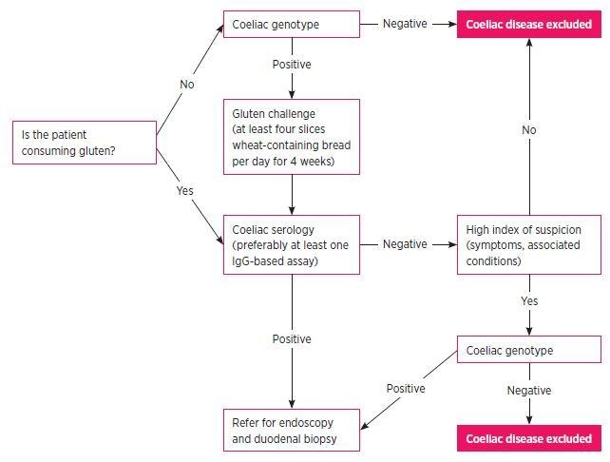
When might genetic testing be useful?
HLA genotyping may be useful to rule out coeliac disease in rare situations:
Coeliac disease serology and/or small bowel examination is inconclusive or equivocal and there remains a clinical suspicion of coeliac disease
When a gluten‐free diet has been commenced prior to serologic/histologic assessment, and the patient is unwilling or unable to restart consuming gluten
There has been failure to improve on a gluten‐free diet
From: Lewis D, Haridy J and Newnham E, ‘Testing for coeliac disease’, Austr Presc 2017; 40: 105-108

Slide 12
References
Tye-Din J, ‘Interpreting tests for coeliac disease: Tips, pitfalls and updates’, AJGP 2018; 47(1-2)
Lewis D, Haridy J and Newnham E, ‘Testing for coeliac disease’, Austr Presc 2017; 40: 105-108
Tye-Din J, Cameron D, Daveson A et al. ‘Appropriate clinical use of human leukocyte antigen typing for coeliac disease: an Australasian perspective’, IMJ 2015; 45(4): 441-450

Slide 13
How this case study was made
This case study was developed through the RACP Evolve initiative. It was drafted by Dr Sern Wei Yeoh based on an Evolve recommendation on low-value practices.
This case study has been reviewed by the RACP Evolve Policy Reference Group in particular Prof Jane M Andrews, the Gastroenterological Society of Australia in particular Dr Diana Lewis and Dr James Haridy, the Royal College of Pathologists of Australasia in particular Dr Debra Graves and NPS MedicineWise.
This case study was approved for publication by the Gastroenterological Society of Australia in August 2020.

Slide 14
Evaluation
How likely is this Evolve recommendation to change your practice?
Not at all
Somewhat
Significantly
Explain your reasoning

Slide 15
choosingwisely.org.au

