Slide 1




It’s OK to ask questions
“
Join the conversation
about unnecessary tests,
treatments and procedures
”
Notes:
Hello and welcome to today’s presentation about Choosing Wisely Australia – part of an international healthcare initiative that’s encouraging health consumers to have better conversations about the healthcare options being recommended to us by our doctors and other health professionals. For instance, discussing the necessity of an x-ray, or the side effects of medications?
Today I’m presenting to you in my capacity as [introduce yourself and your role within the consumer health advocacy space].
I’ll be covering what Choosing Wisely is about, it’s key messages and share with you some engagement tools I hope you’ll share with your own advocacy networks.
So, let’s get started…

Slide 2
What is Choosing Wisely Australia?
A campaign to reduce unnecessary tests, treatments and procedures through better conversations
Health consumers
and healthcare providers can work together
“
Challenging the notion
‘more is better’ when it comes to healthcare…
”
Notes:
Choosing Wisely was launched in Australia by NPS MedicineWise in April 2015. NPS MedicineWise is an independent, not-for-profit and evidence-based organisation that works to improve the way health technologies, medicines and medical tests are prescribed and used.​
The initiative is working to bring together health professionals and health consumers in better conversations about the appropriateness of tests, treatments and procedures – working to reduce the number of low-value practices that may be unnecessary or, in some instances, may even cause harm. And it’s challenging the notion that “more is better” when it comes to healthcare.
Choosing Wisely Australia is led by the health profession, with Australia’s specialist health professional colleges, societies and associations providing the latest evidence-based advice on healthcare that should be questioned.
The initiative is consumer focused – with the aim of improving health outcomes for Australians by helping people better understand their healthcare options and avoiding care that may be unnecessary. Members include the Consumers Health Forum of Australia and HealthDirect Australia.
Many health services across the country are also implementing Choosing Wisely related projects in their hospitals.

Slide 3
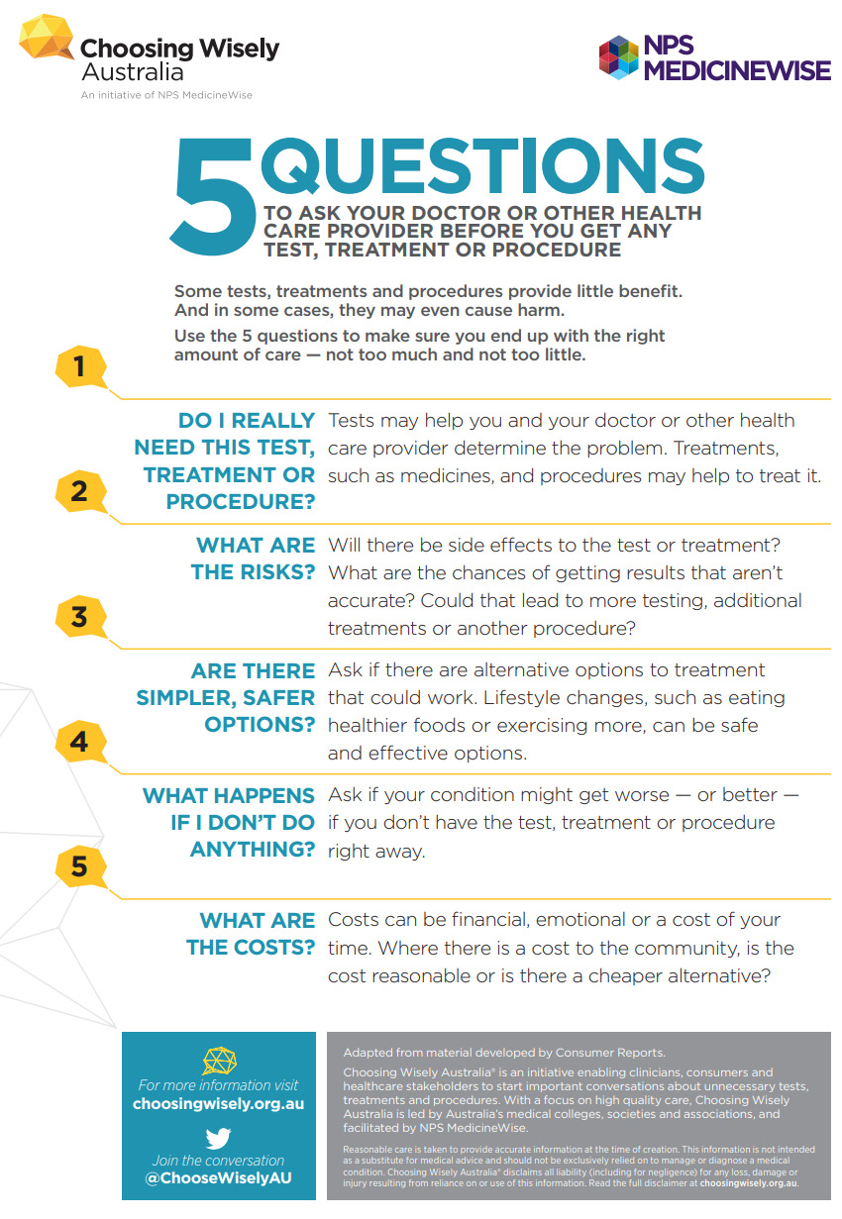
5 Questions to ask
There are risks and benefits associated with all tests, treatments
and procedures
It’s important to ask questions to be fully informed about options
Notes:
All tests, treatments and procedures have benefits and risks for health consumers. However, Choosing Wisely recognises not everyone has the confidence, or feels comfortable, questioning the recommendation of a doctor. However, this is not about undermining a doctor’s expertise, it is about ensuring that health consumers ask questions and receive the answers they need before deciding about a particular test, treatment or procedure.
To help guide conversations during a consultation, Choosing Wisely Australia offers two useful resources.
The first is 5 Questions to ask your doctor or other healthcare provider:
Do I really need this test, treatment or procedure? Tests may help you and your doctor or other health care provider determine the problem. Treatments, such as medicines, and procedures may help to treat it.
What are the risks? Will there be side effects to the test or treatment? What are the chances of getting results that aren’t accurate? Could that lead to more testing, additional treatments or another procedure?
Are there simpler, safer options? Are there alternative options to treatment that could work. Lifestyle changes, such as eating healthier foods or exercising more, can be safe and effective options.
What happens if I don't do anything? Ask if your condition might get worse — or better — if you don’t have the test, treatment or procedure right away.
What are the costs? Costs can be financial, emotional or a cost of your time. Where there is a cost to the community, is the cost reasonable or is there a cheaper alternative?

Slide 4
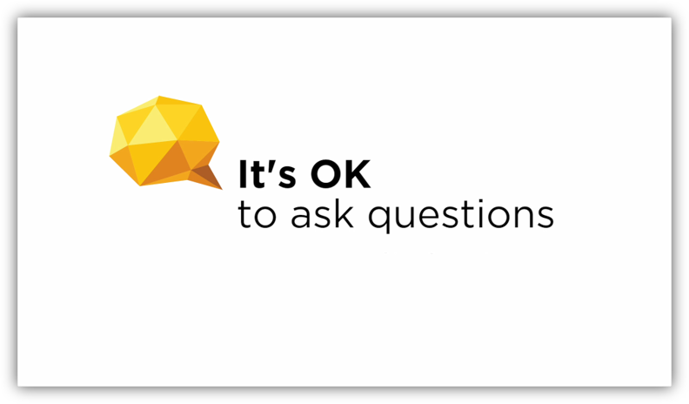
Notes:
Now I’m going to play a short video demonstrating the value of asking these five questions during a medical appointment. This is also available on the website.
Note: This video is embedded from YouTube and requires internet connection.

Slide 5
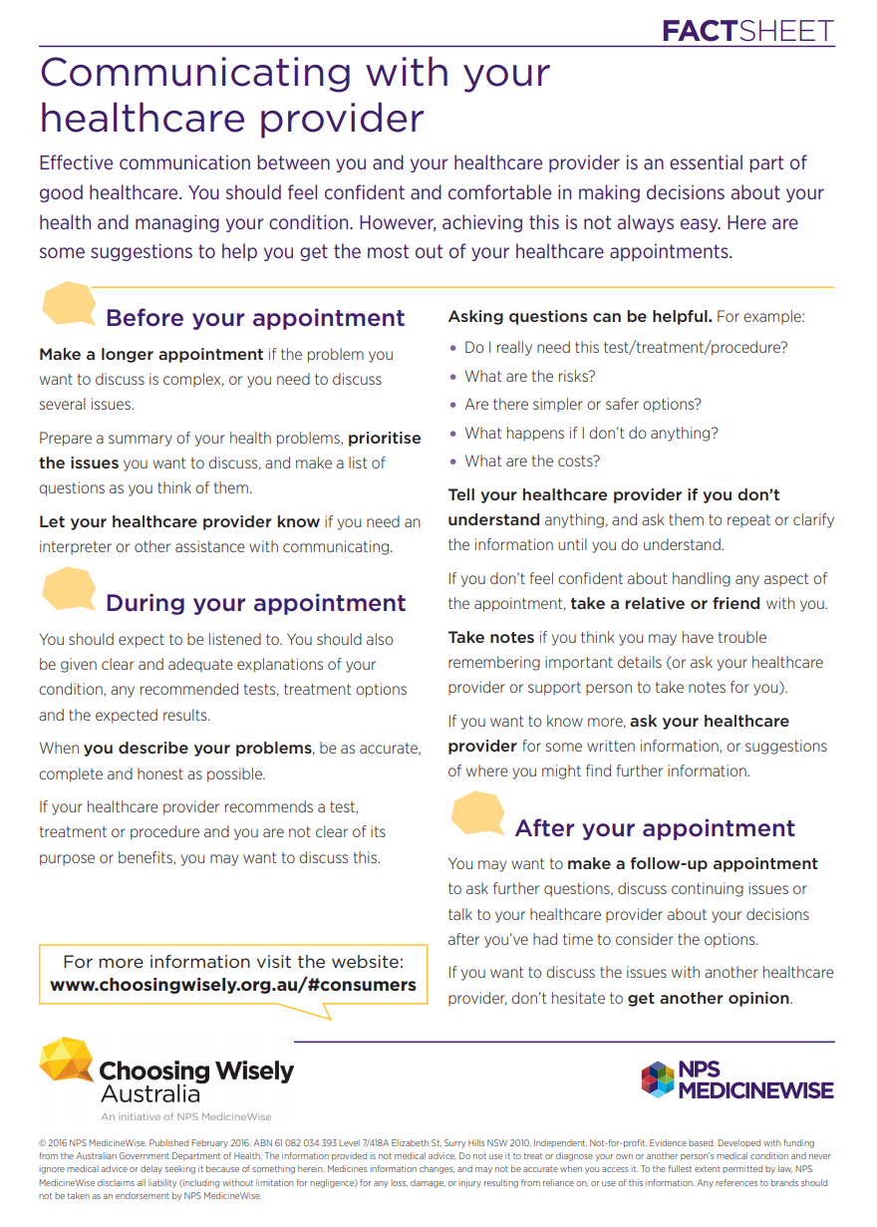

Communications tips
Preparing
for an
appointment
Advice to help consumers overcome barriers to asking questions about their
healthcare options
Notes:
I mentioned two useful resources for consumers. The second is this tip sheet on Communicating with your healthcare provider.
This is a great tool because there are many reasons why a health consumer might not ask the questions they need to during an appointment. For example:
Sometimes they intend to ask questions but simply forget once they’re with the doctor
The doctor might seem rushed
They might be feeling upset or anxious and can't take in what the doctor is saying.
Both the resources I mentioned are available from the Choosing Wisely Australia website, along with videos and the latest advice on tests, treatments and procedures to question.

Slide 6
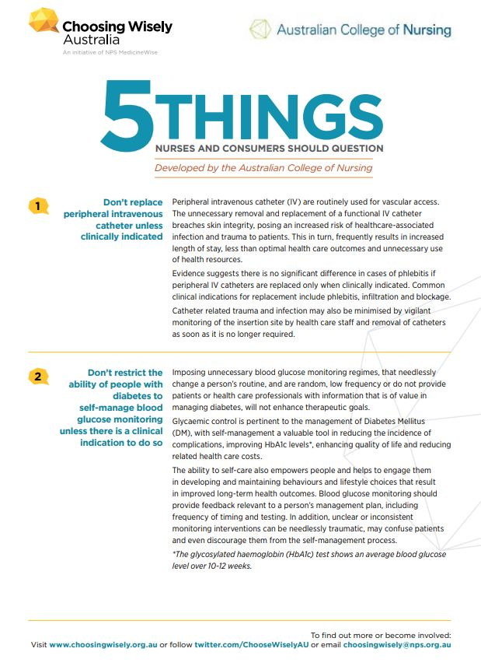
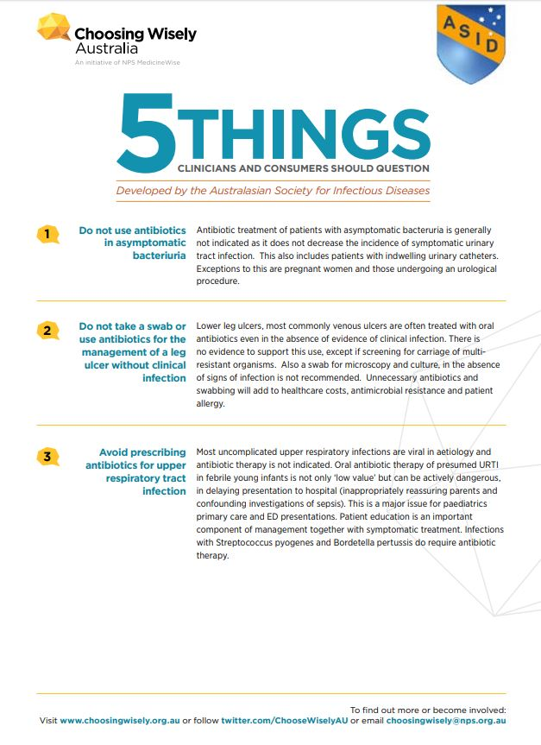
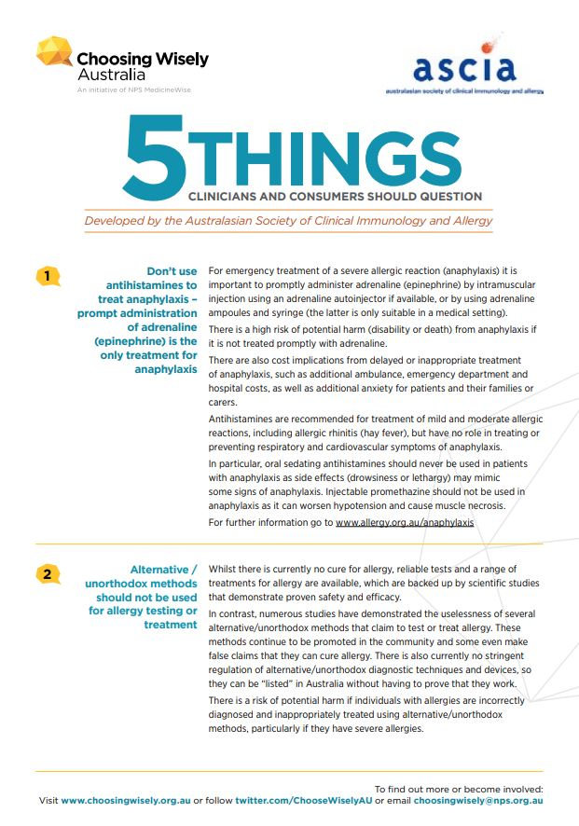
Changing healthcare advice
Notes:
Choosing Wisely Australia publishes the latest evidence-based advice on a whole range of healthcare practices that clinicians and consumers should question. This includes things like pathology, use of antibiotics and other medications, imaging and surgeries.
These recommendations are developed by Australia’s specialist health professional colleges, societies and associations and are promoted by Choosing Wisely in lists of 5 things to question.
As I mentioned earlier, many hospitals across Australia are becoming Choosing Wisely Champions and are using these recommendations to reduce unnecessary tests, treatments and procedures in our hospitals.

Slide 7
How you can help
Organise
a consumer health
session with this presentation
Promote
the 5 Questions
and tips for communicating
Share
the Choosing Wisely messages with
your networks
Notes:
As health consumer advocates, Choosing Wisely offers us another avenue for promoting patient-centered care and through which we can promote better health outcomes in our communities.
By using this presentation and the resources available, it would be wonderful if you could share the benefits of Choosing Wisely and the value of good doctor-patient conversations in helping reduce unnecessary healthcare.
Here are some ideas of how you can participate:
Share Choosing Wisely messages with your networks
Organise a consumer health session and use this presentation.
Promote Choosing Wisely 5 Questions and communication resources
Display the 5 questions posters
Join the conversation on social media

Slide 8





Get involved
Tweet using
#ChoosingWisely
@ChoosingWiselyAU
Facebook/choosingwisely
Like and share
Facebook posts
Choosing Wisely Australia
Notes:
If you’d like to find out more about Choosing Wisely Australia and access all the consumer resources available, visit choosingwisely.org.au. You can also sign up to their quarterly newsletter.
You can also follow Choosing Wisely Australia’s activities on social media:
On Twitter at: @ChooseWiselyAU
Facebook: Choosing Wisely Australia
And similarly, on LinkedIn.
Thank you for your time today.

